Slide 1
Wayne Hummer -- Wayne Hummer & Company
Wayne Hummer -- Wayne Hummer & Company

Slide 4
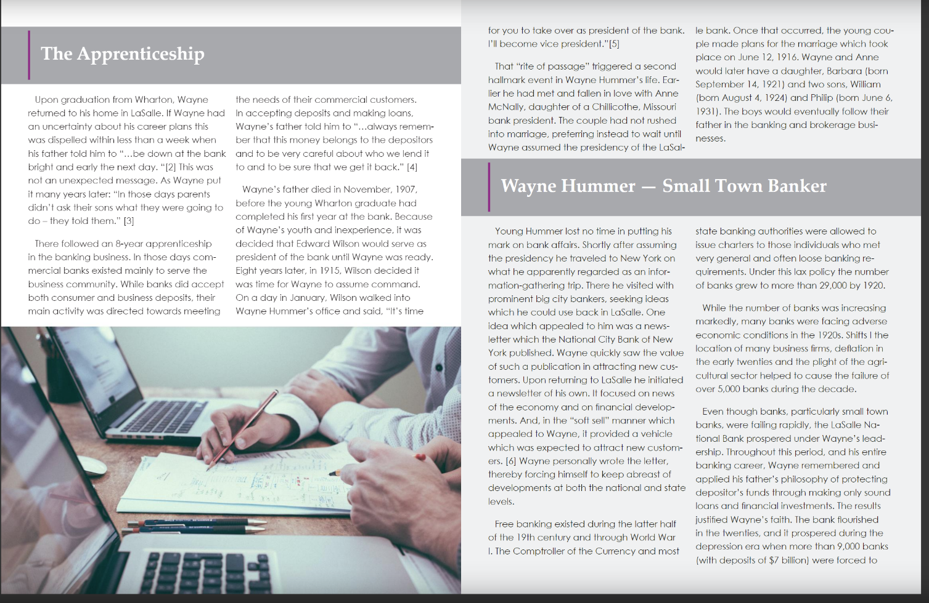

Slide 7
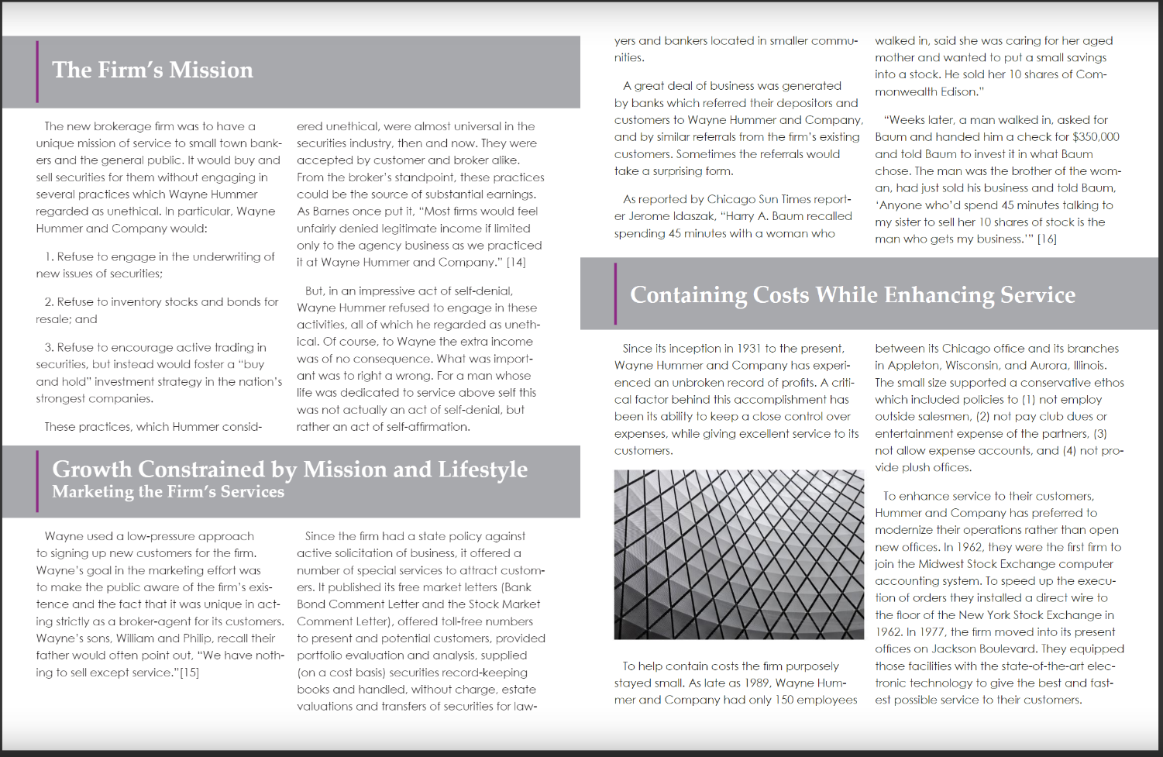

Slide 8
