Slide 1
W. A. “Pat” Patterson -- United Air Lines
W. A. “Pat” Patterson -- United Air Lines

Slide 2
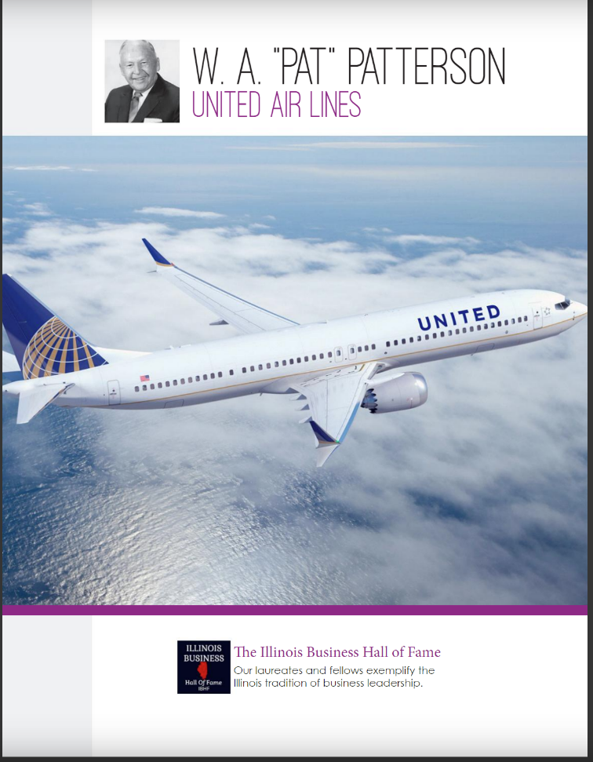

Slide 3
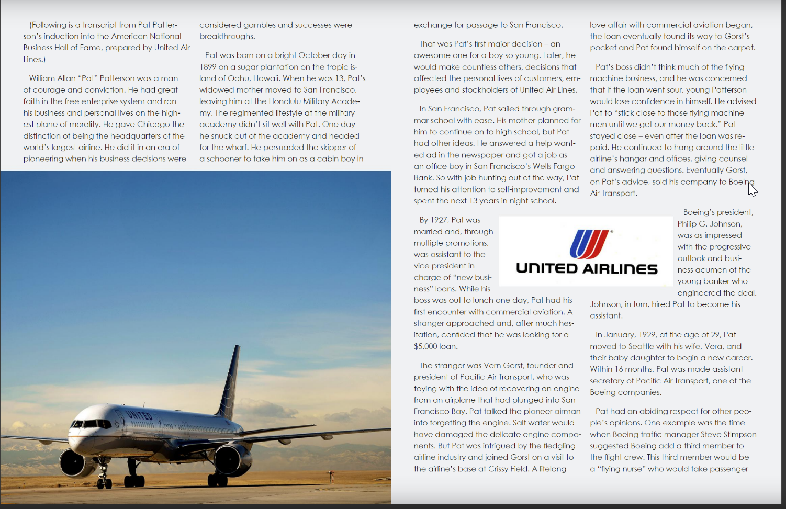

Slide 4
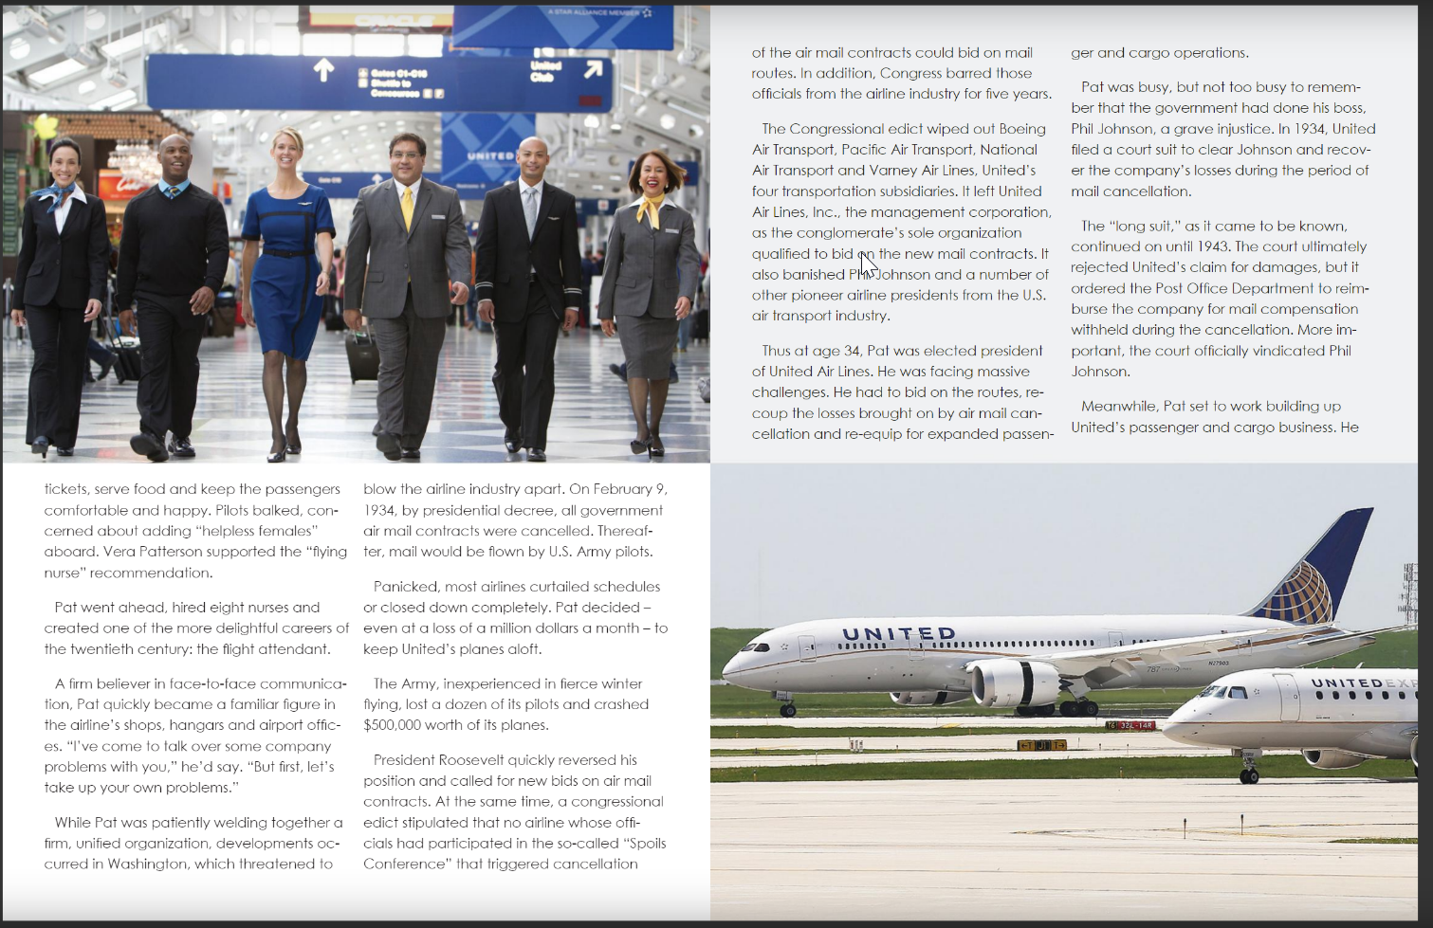

Slide 5
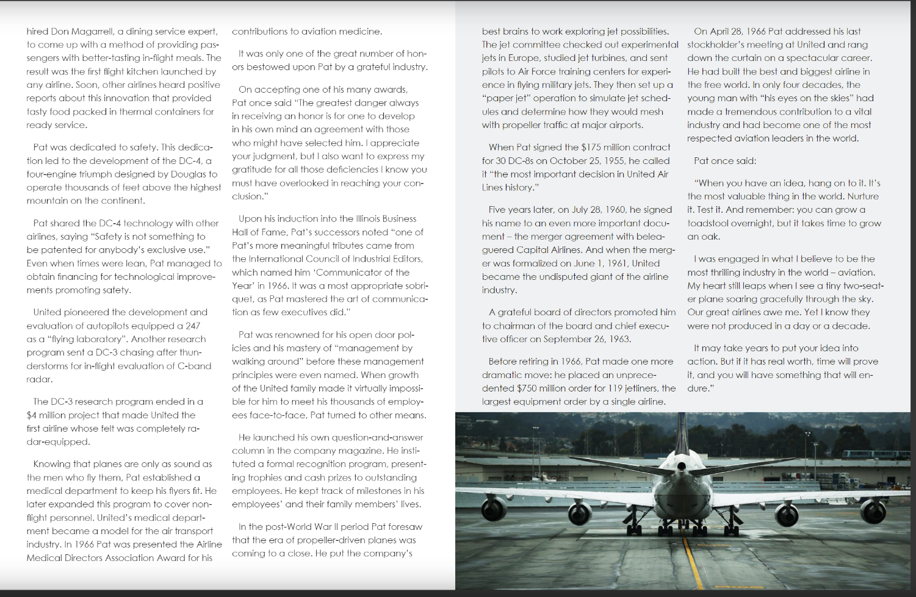

Slide 6


