Slide 1
Ray Kroc -- Mcdonald's
Ray Kroc -- Mcdonald's

Slide 2
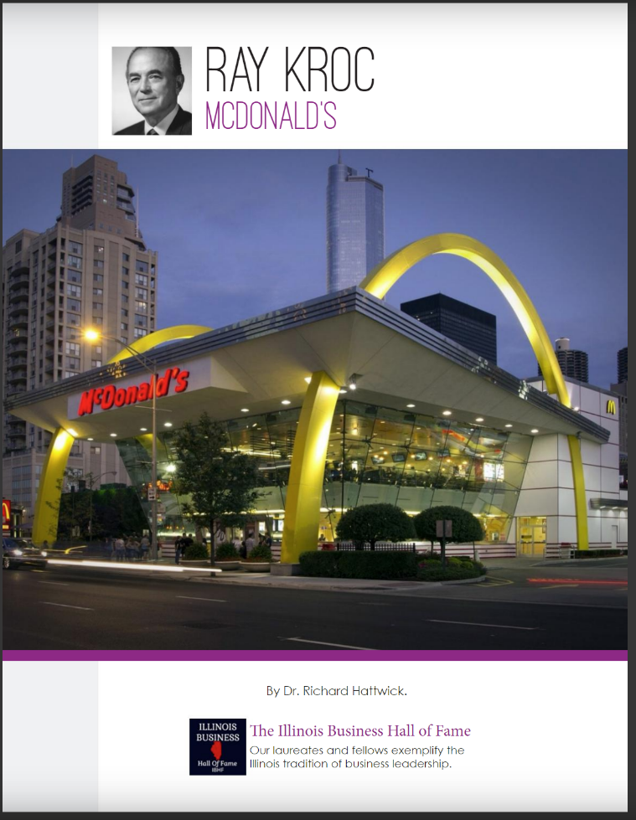

Slide 4
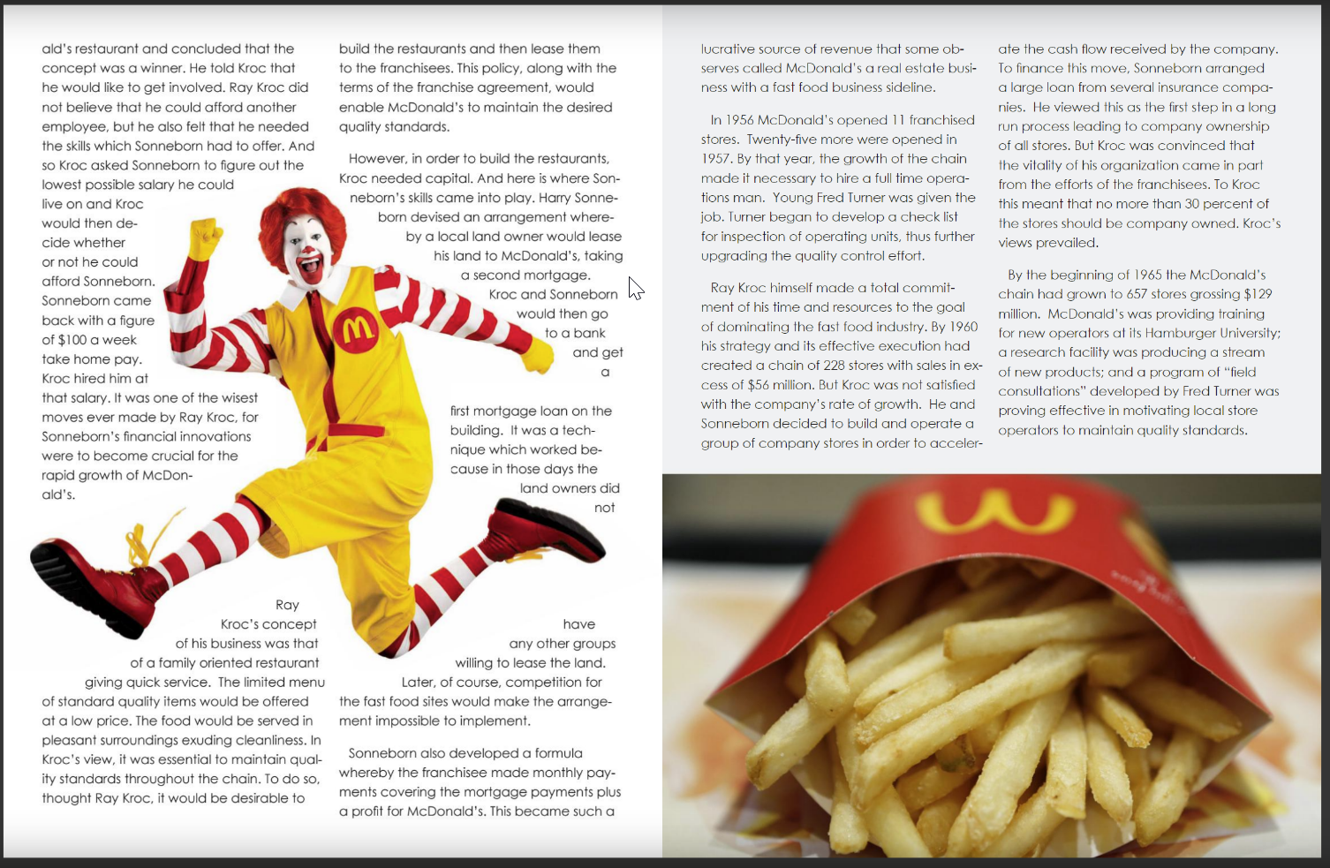

Slide 5
