Slide 1
R.J. FRISBY -- R.J. Frisby Manufacturing Company
R.J. FRISBY -- R.J. Frisby Manufacturing Company

Slide 2


Slide 3
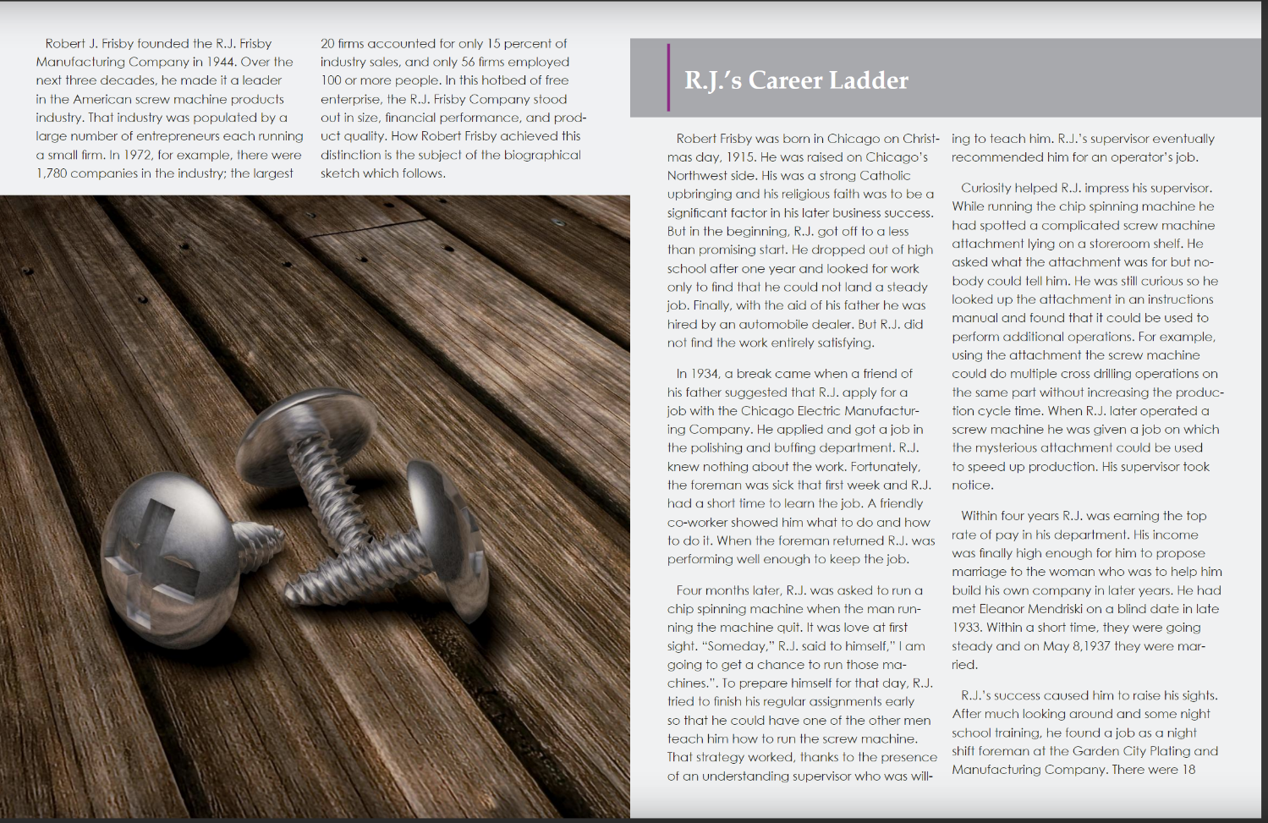

Slide 4
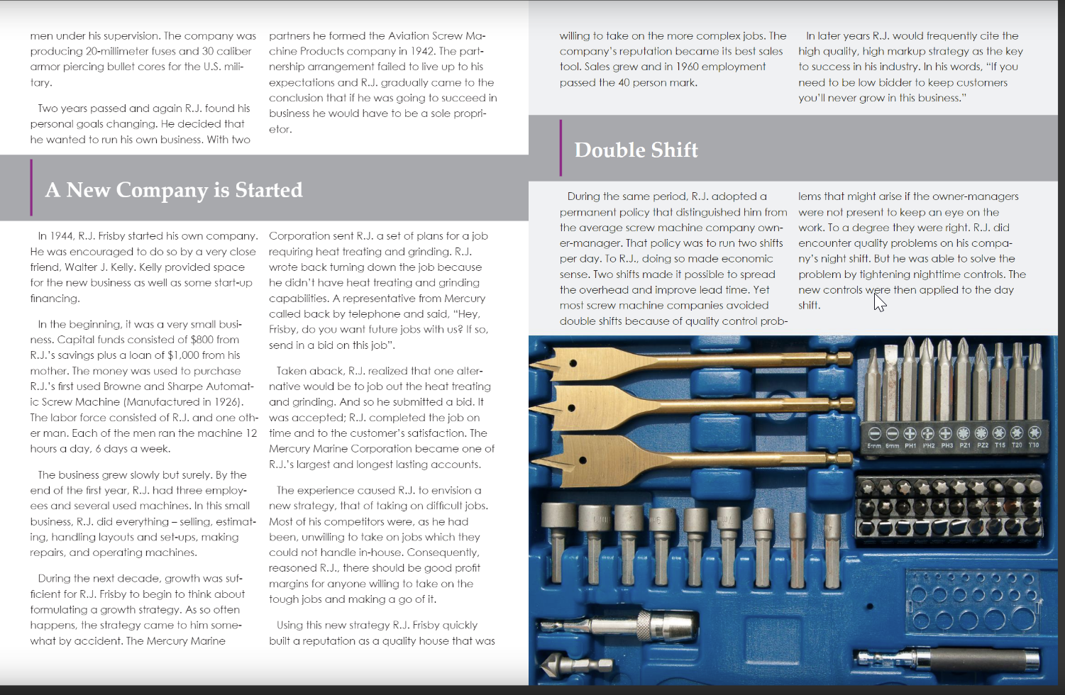

Slide 5
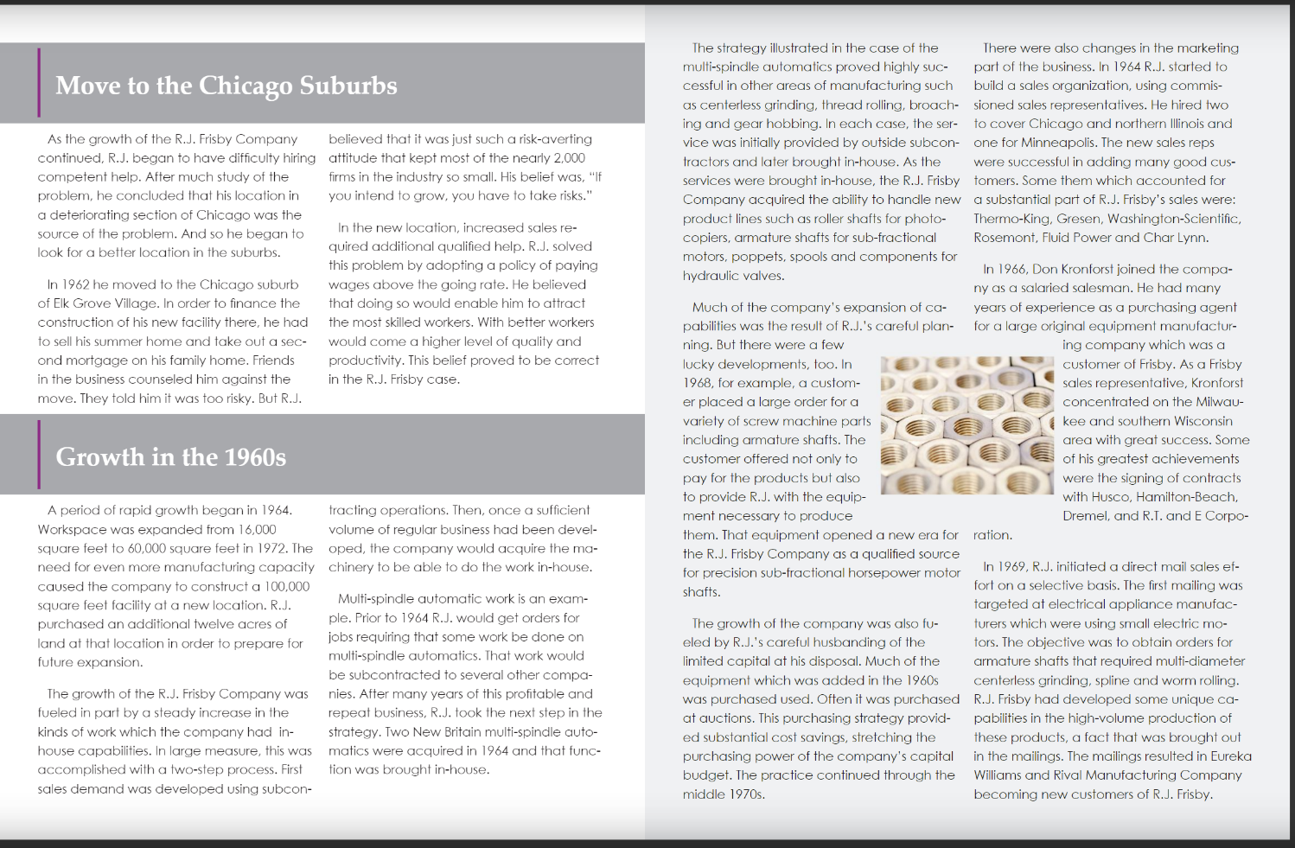

Slide 6
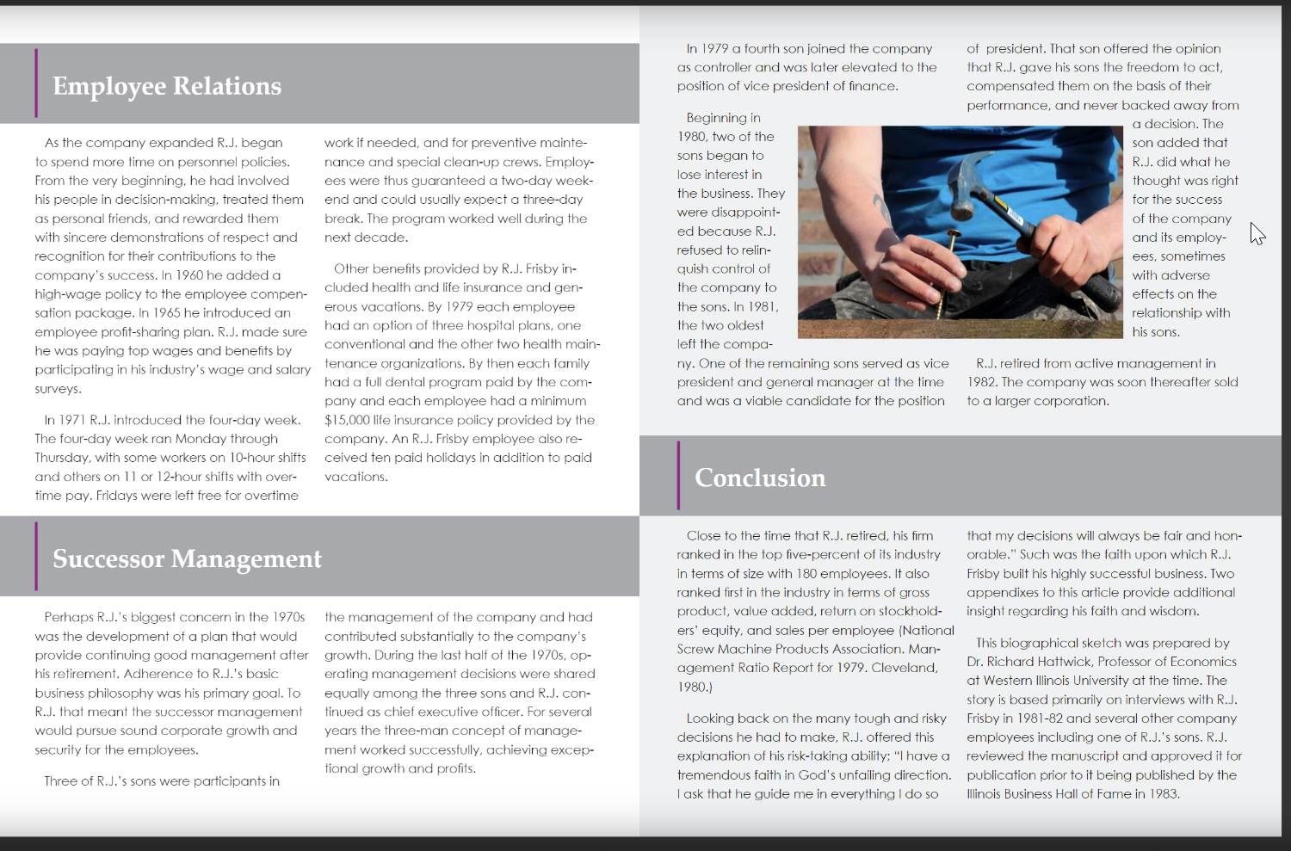

Slide 7
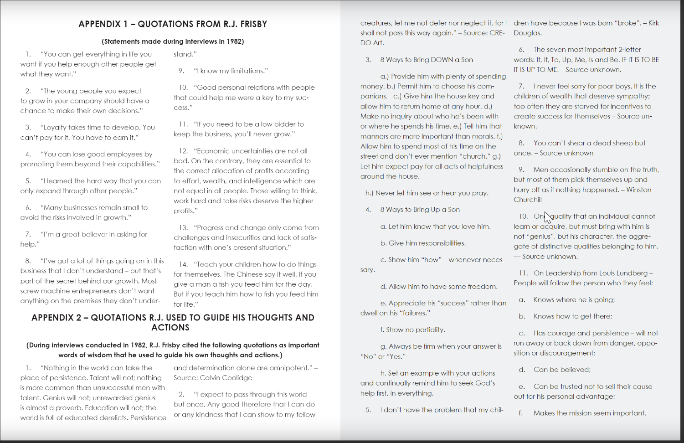

Slide 8
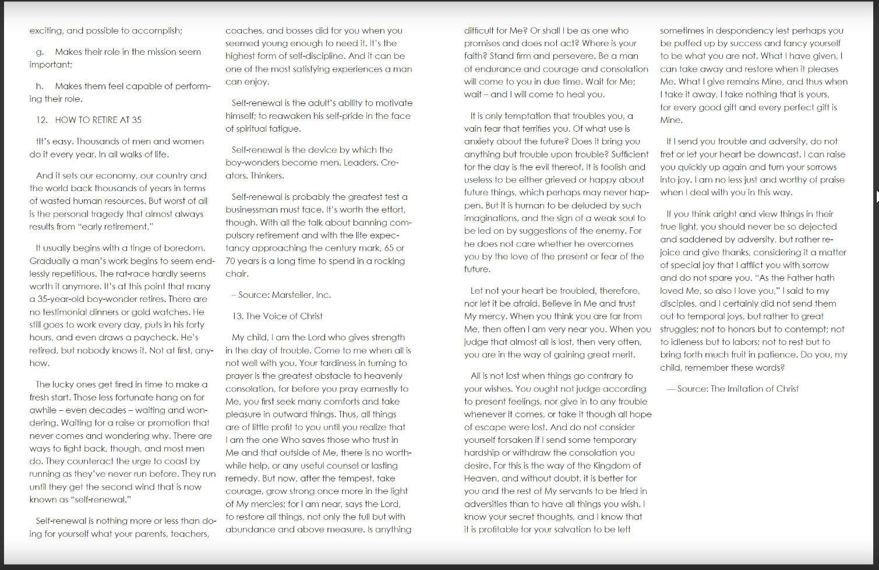

Slide 9


