Slide 1
Marion Wade -- Servicemaster
Marion Wade -- Servicemaster

Slide 4
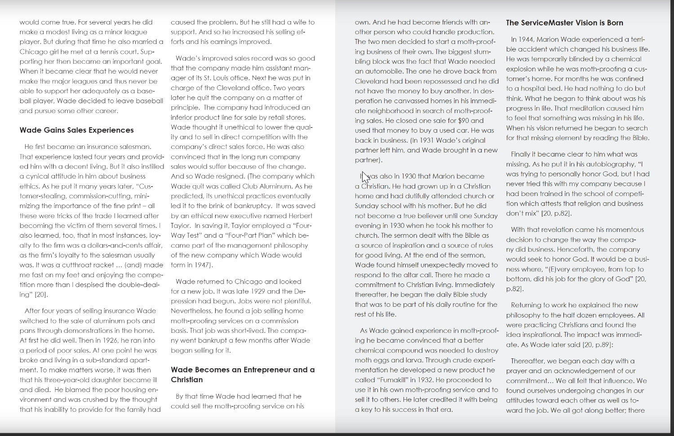

Slide 5
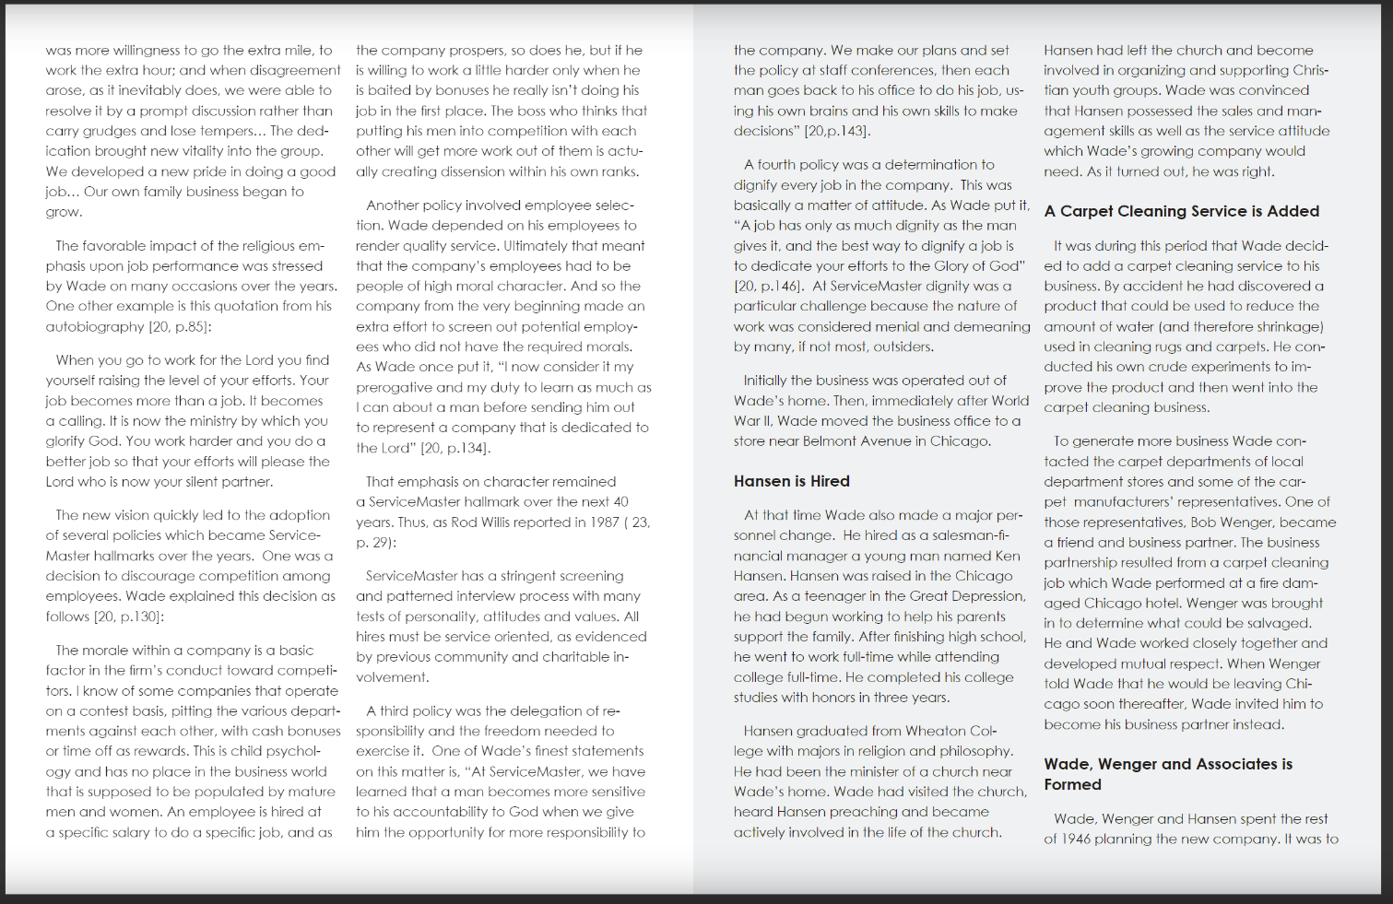

Slide 6
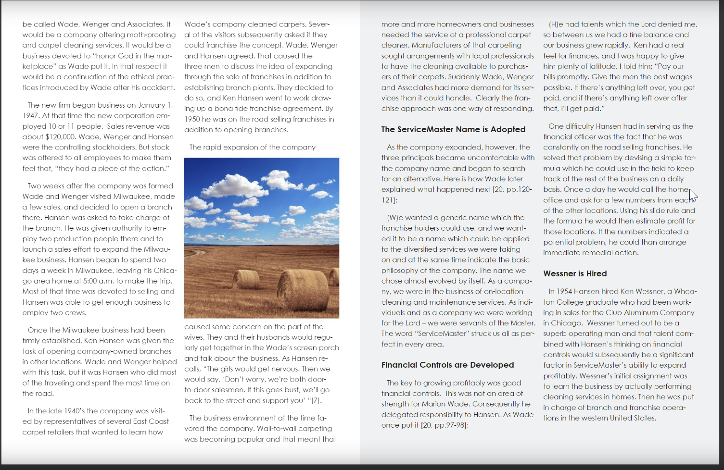

Slide 9
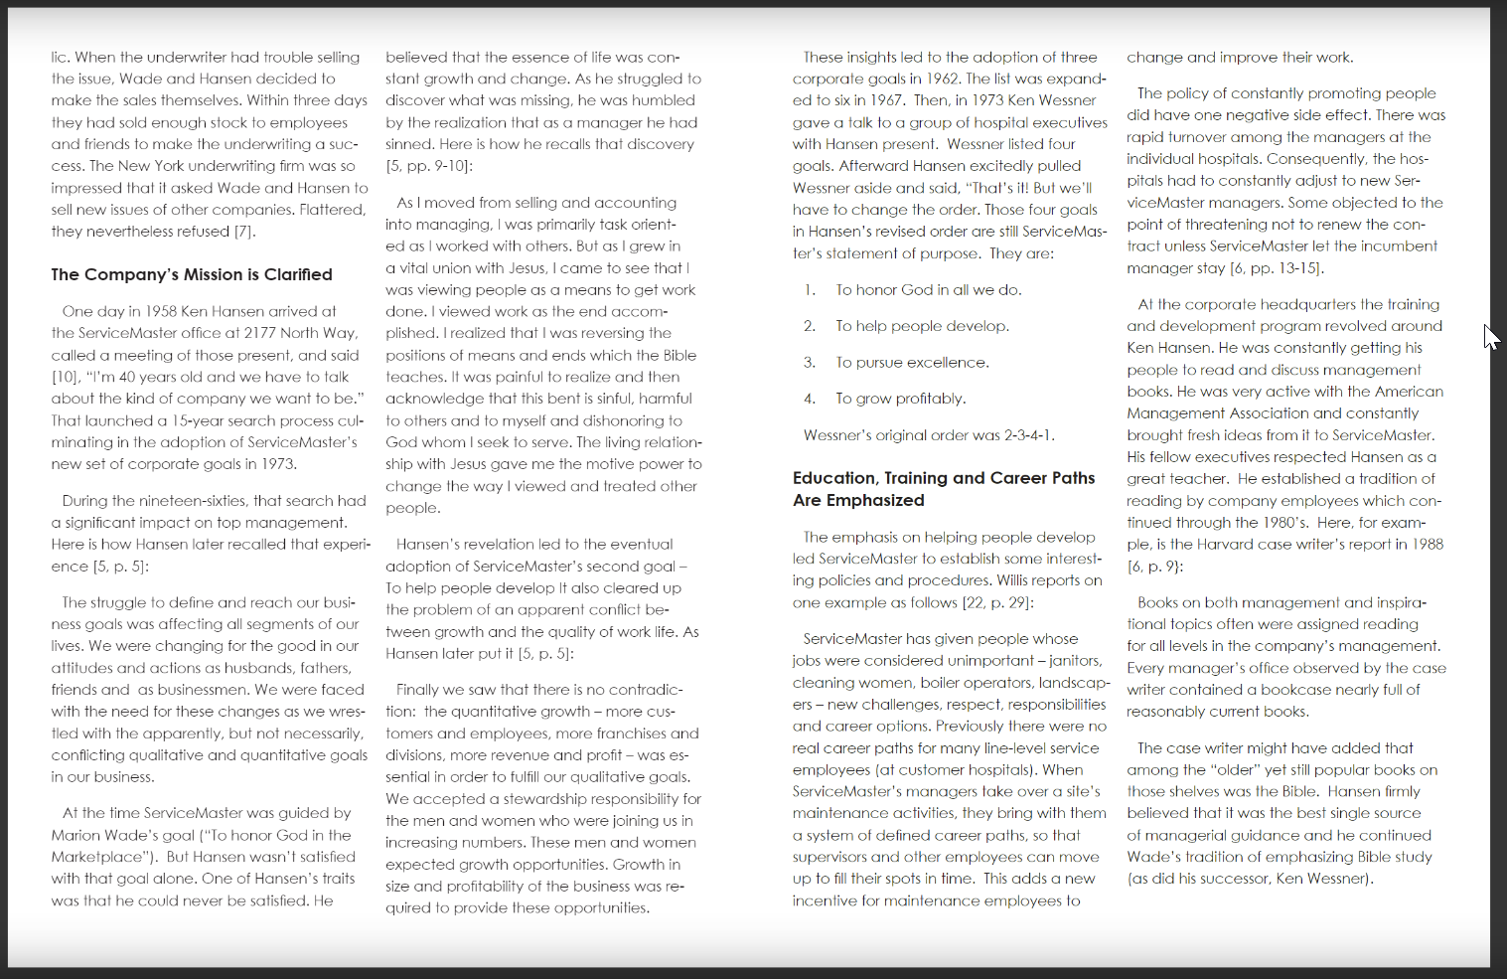

Slide 11
