Slide 1
Leo Burnett -- Leo Burnett Company, Inc
Leo Burnett -- Leo Burnett Company, Inc

Slide 2
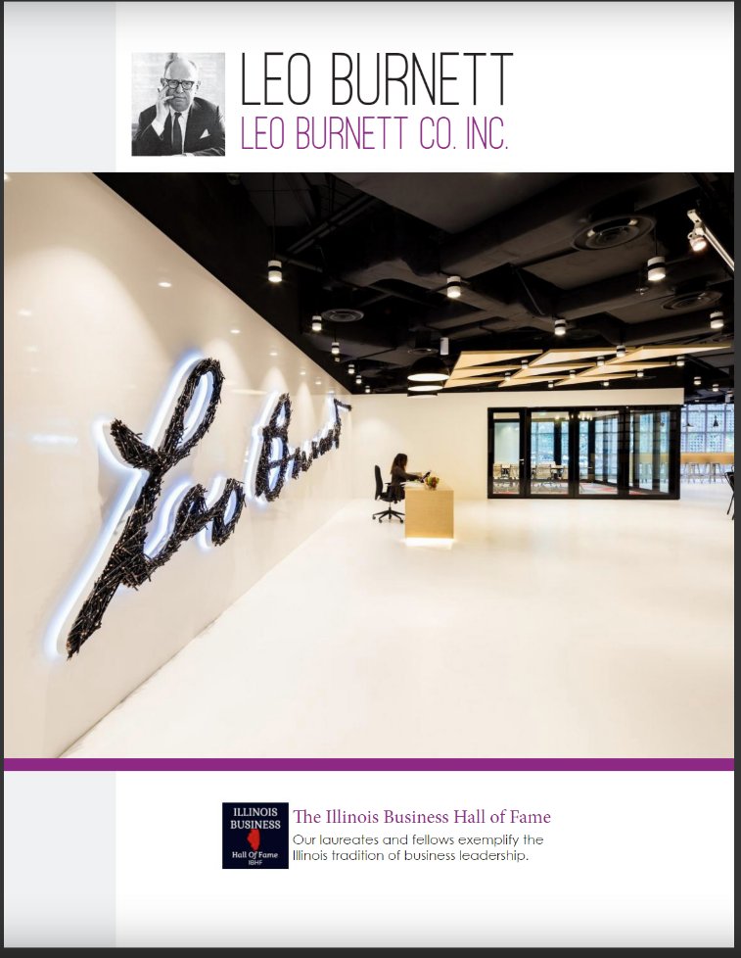

Slide 3
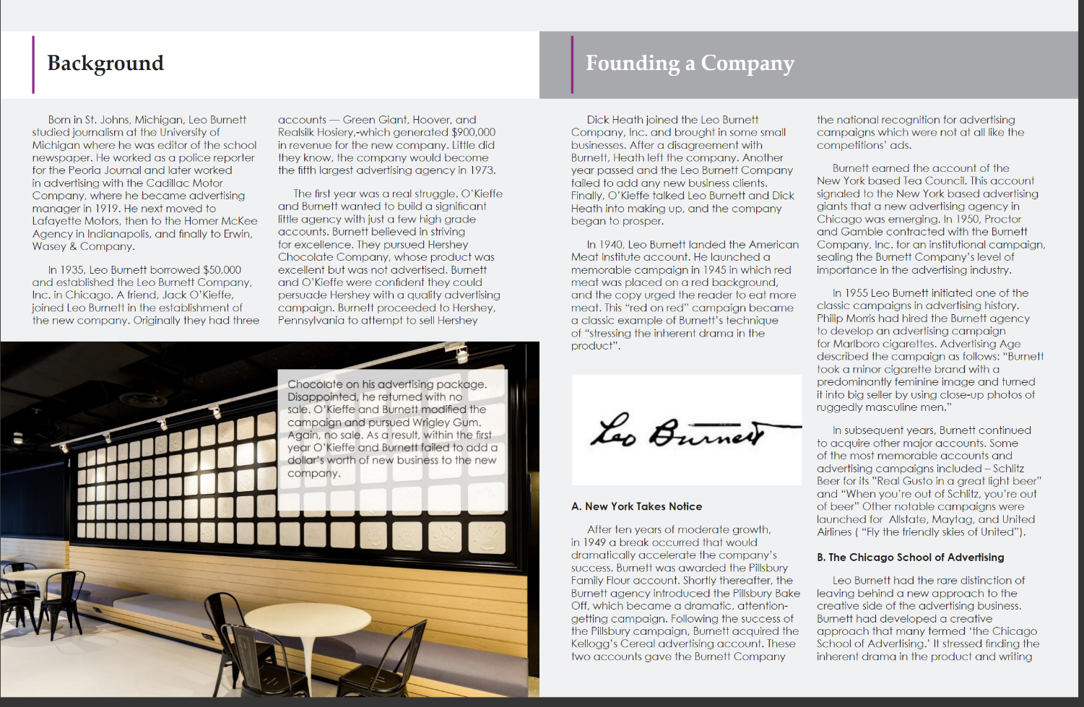

Slide 4
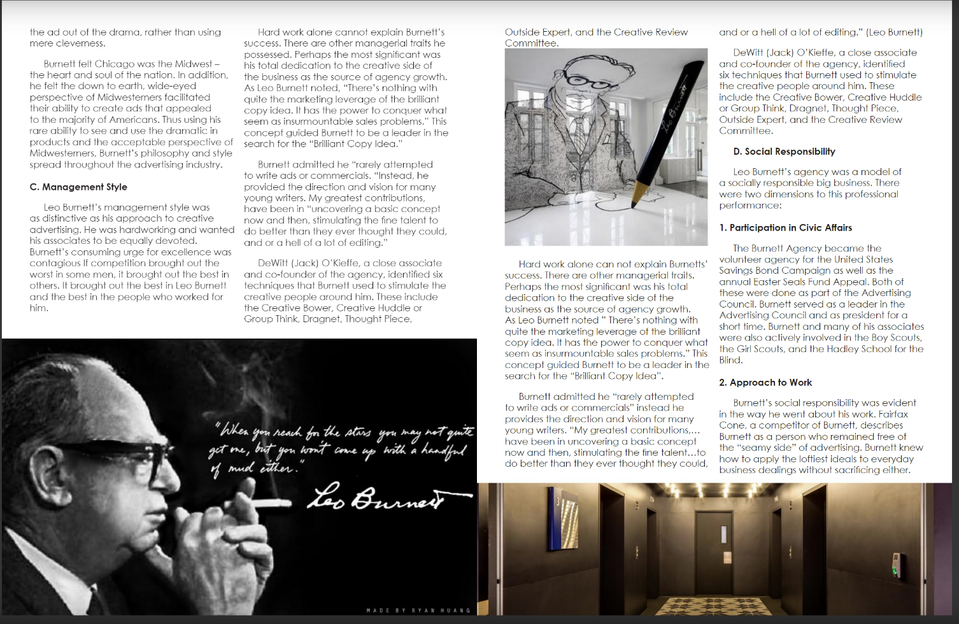

Slide 5
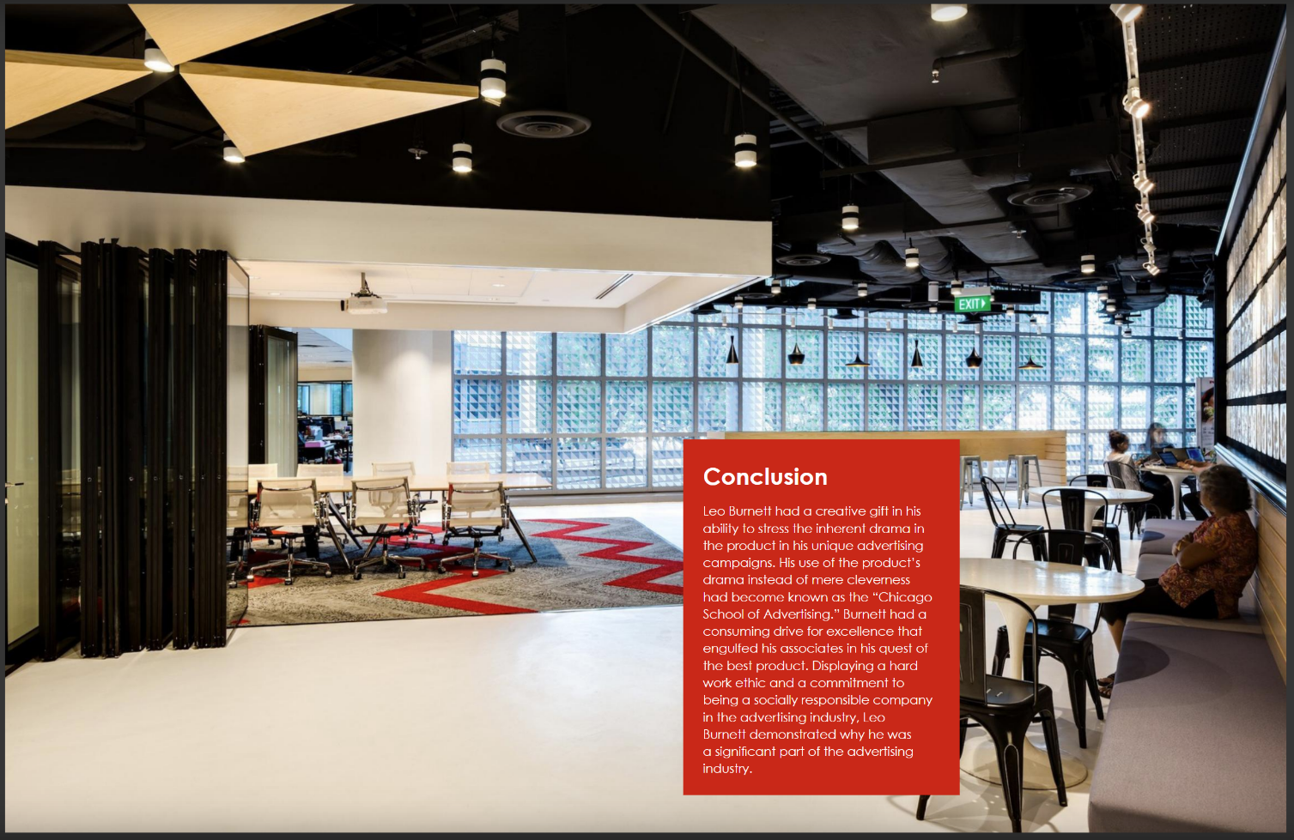

Slide 6


