Slide 1
Jack Miller -- The Quill Corporation
Jack Miller -- The Quill Corporation

Slide 2


Slide 3
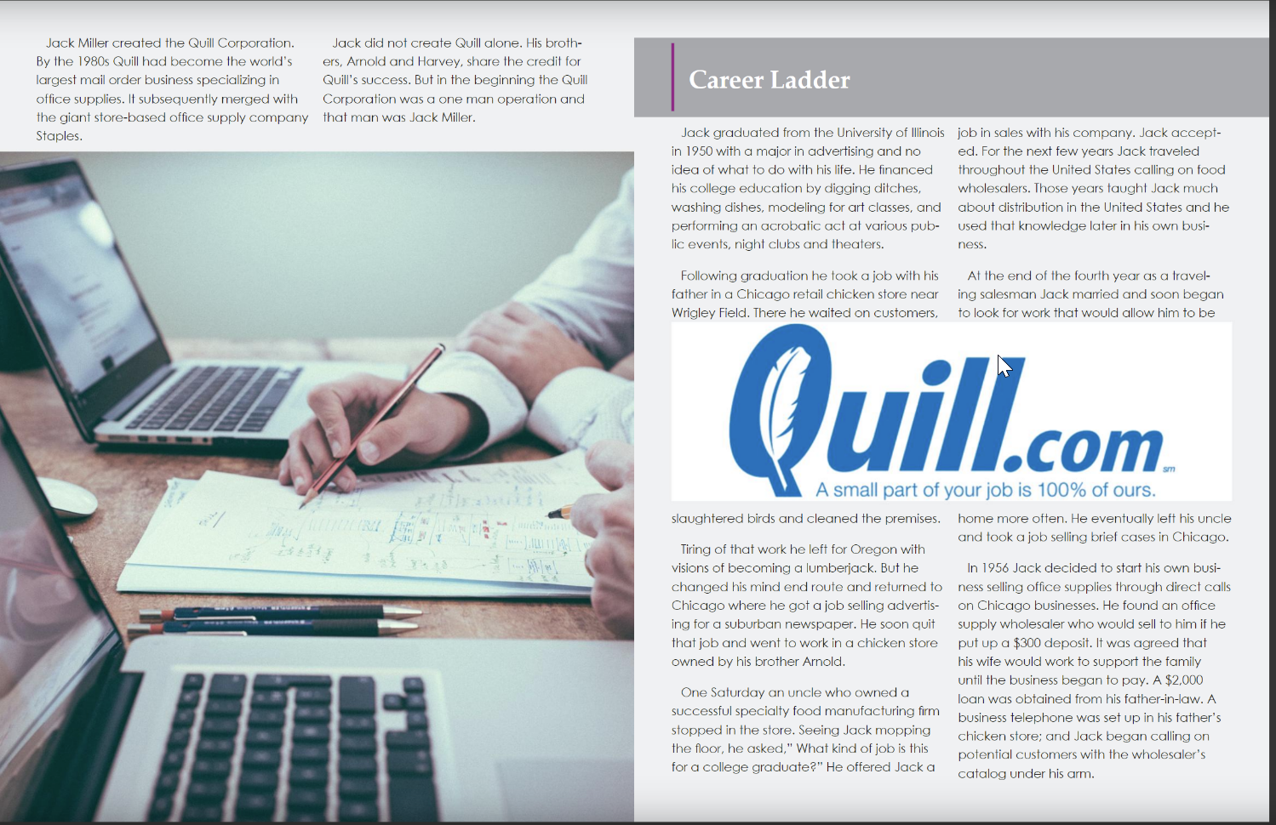

Slide 4


Slide 5


Slide 6


