Slide 1
Gust E. “Brick” Lundberg -- Sandy’s
Gust E. “Brick” Lundberg -- Sandy’s

Slide 2
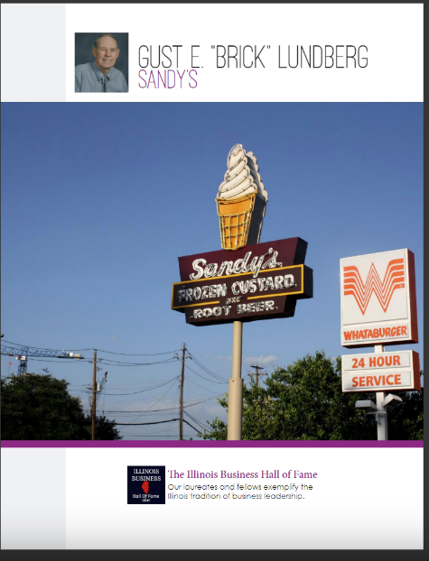

Slide 3
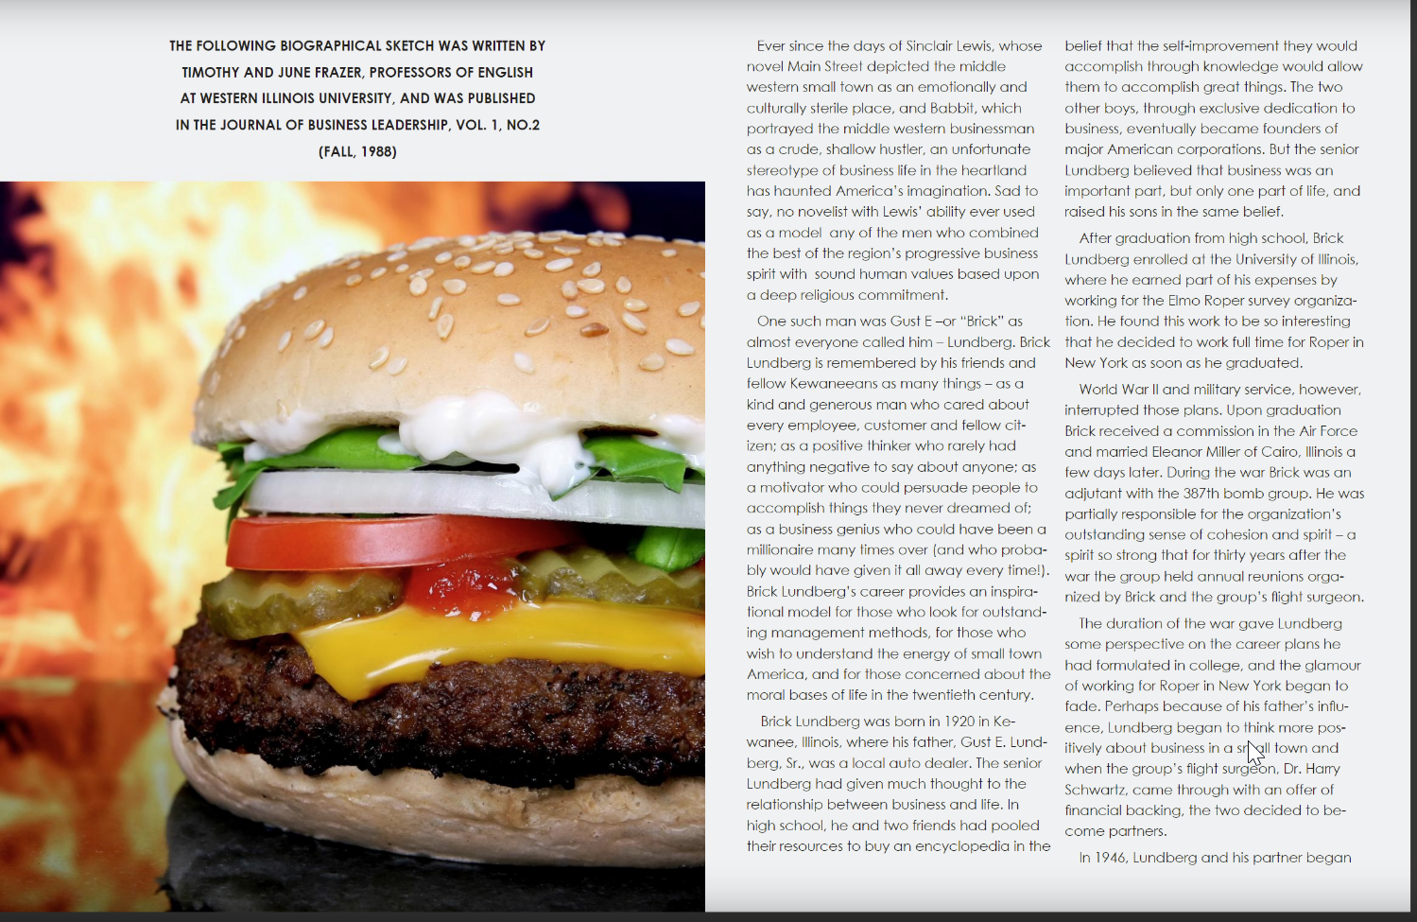

Slide 4
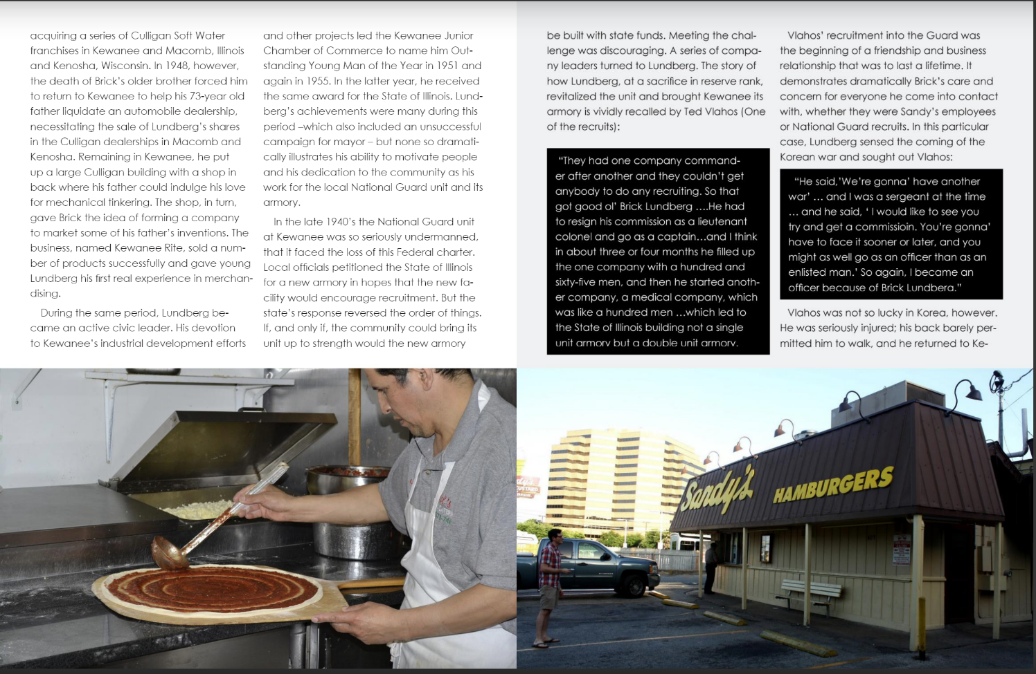

Slide 5
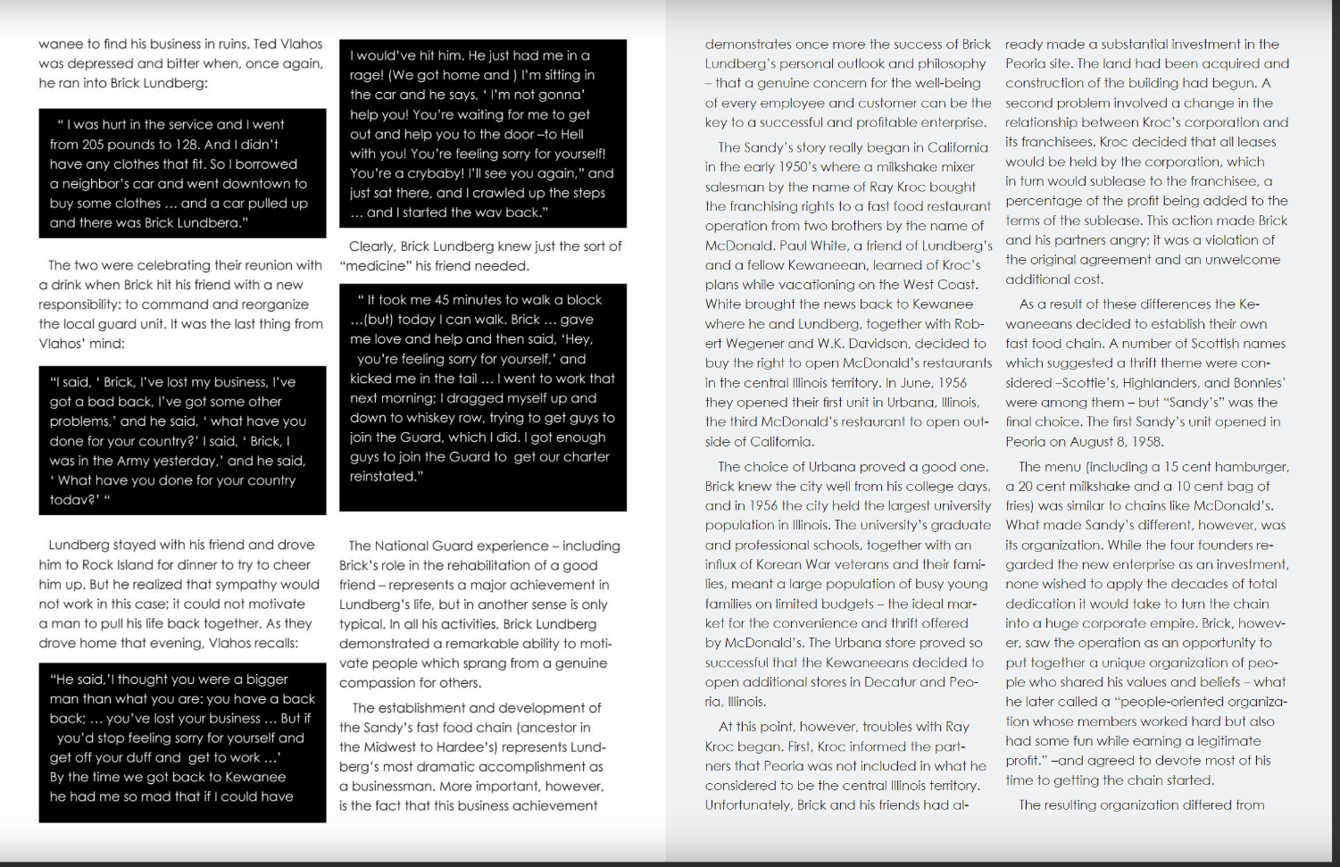

Slide 6
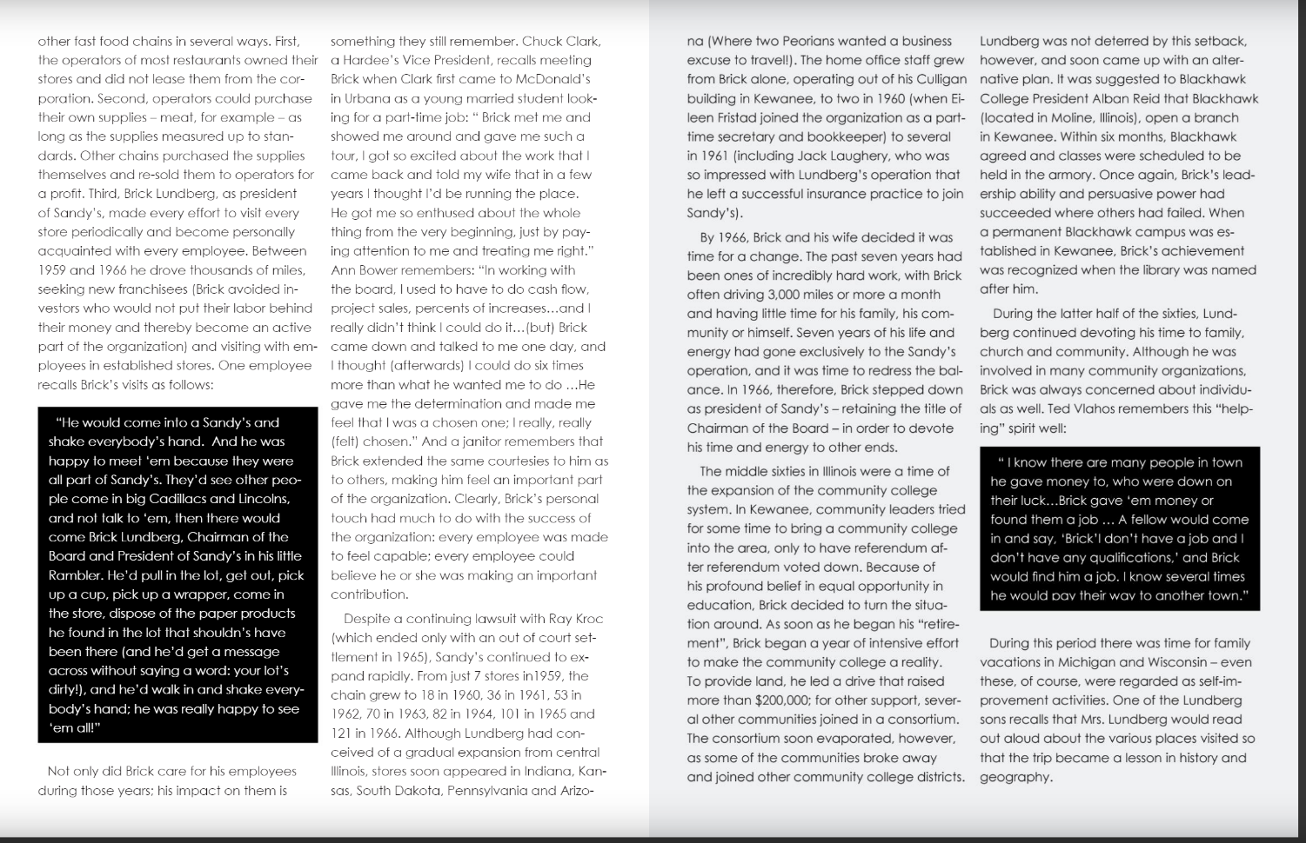

Slide 7
