Slide 1
Fairfax Cone -- American Association of Advertising Agencies
Fairfax Cone -- American Association of Advertising Agencies

Slide 2


Slide 3
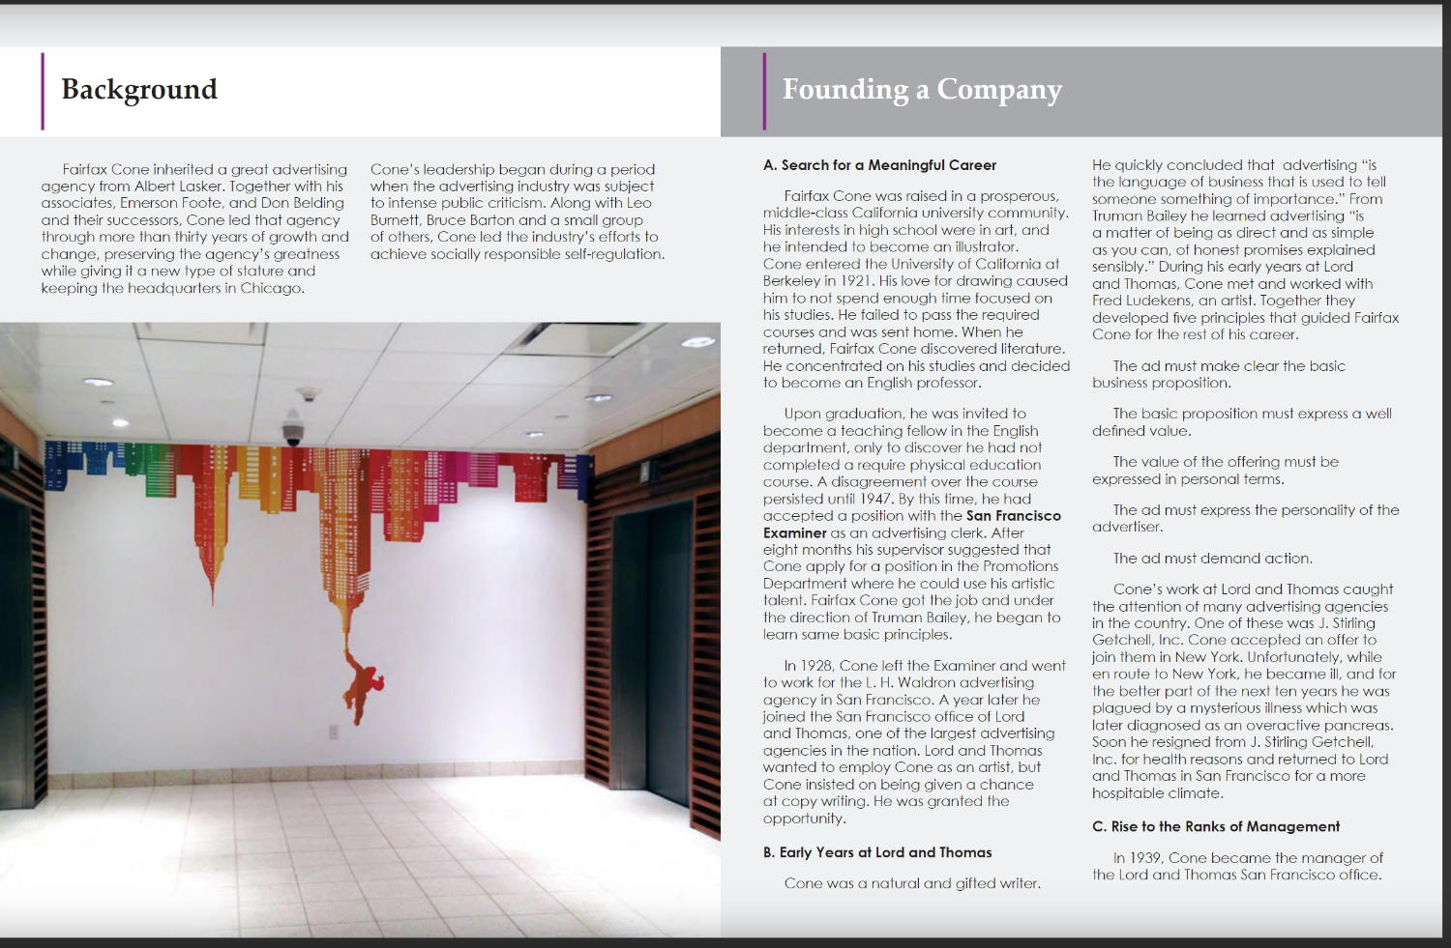

Slide 4
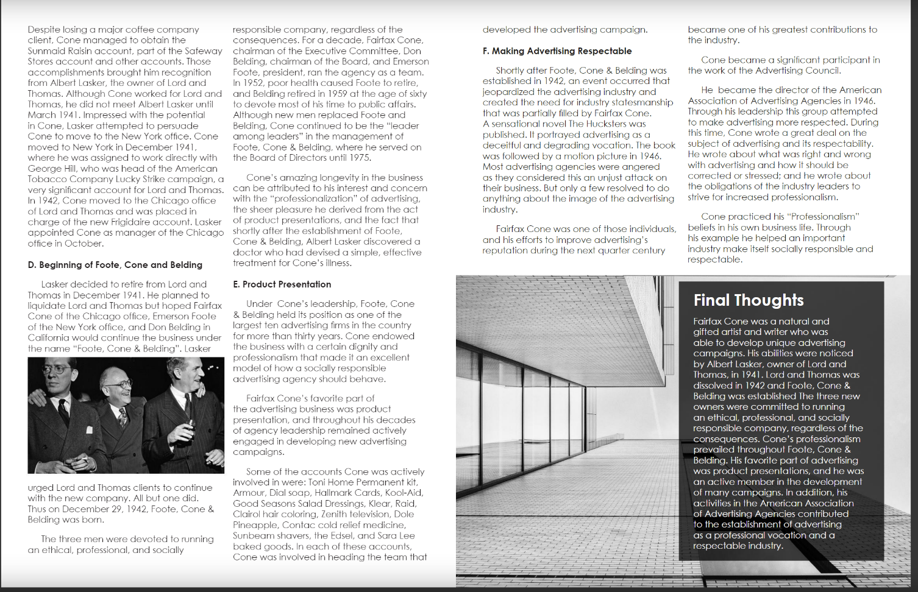

Slide 5


