Slide 1
Eugene McDonald -- Zenith Radio Corporation
Eugene McDonald -- Zenith Radio Corporation

Slide 2
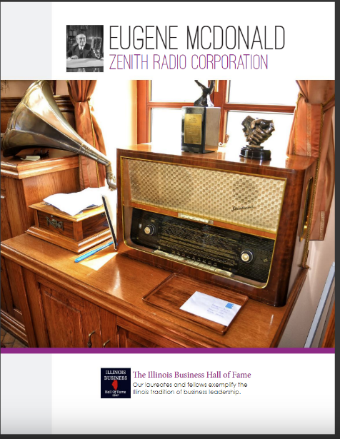

Slide 4
